Slide 1
Managing PostgreSQL on Windows/Ubuntu

Slide 2
Outline
The pgAdmin
Parts of the PostgreSQL system
Practices – Create a new application

Slide 3
localhost
Port: 5432
Account: postgres
Password: admin

Slide 4
1. The pgAdmin (pgadmin III / pgadmin4)

Slide 5
The pgAmin
Any function you need to perform on your PostgreSQL system you can do from within the pgAdmin III/ pgAdmin IV graphical interface
Location: ~bin\pgadmin3.exe
Default:
localhost
port: 5432
Add new connect: File→Add server
Connect server: right click → Connect

Slide 8
2. Practices – Create a new application

Slide 9
Practices – Create a new application
Create a database test
Customer
Product
Order
Create two Group Roles (later)
Salesman Group Role: write permission on the Customer and Order, only read permission on the Product
Accountant Group Role: write permission on the Product and Order, read permission on the Customer
Create two Login Roles (later)
salesman - Barney
accountant - Fred

Slide 10
Creating a New Database
Notes:
You need to use a full 8-bit character encoding
the template0 and template1 templates
After the template choice comes the tablespace. In most situations, you should use the pg_default tablespace for your new database. Although pgAdmin III offers the pg_global tablespace as an option, you should never create new objects in the pg_global tablespace. It is generally not a good idea to mix your application objects with the system objects. If you had created a new tablespace on your system, it would also appear in the list of options available.

Slide 11
Template
CREATE DATABASE actually works by copying an existing database
Default, it copies the standard system database template1
There is a second standard system database named template0
the same data as the initial contents of template1
never be changed

Slide 12
Creating a New Schema
Notes:
Unlike the public schema, the newly created schema will be protected by default. No users will have access to the schema until we specifically grant them access. This helps provide better security for the application by default.

Slide 13
Schemas (1/3)
The most important objects within the database
A database contains one or more schemas, which contain database object (table, data type, domain, function, trigger) definitions
While users can only access objects within one database at a time, they can access all of the schemas within that database, if it has permissions
Unlike databases, schemas are not rigidly separated
Notes:
Sometimes related applications can share the same database, but use different schemas to hold their separate data. This makes it easier for users to find data tables related to the applications within the database. This is especially true if tables have the same names.
Table names must be unique within a schema, but can be duplicated between schemas. Tables are referenced in SQL statements using the format: schemaname.tablename

Slide 14
Schemas (2/3)
Sometimes related applications can share the same database, but use different schemas to hold their separate data. This makes it easier for users to find tables related to the applications within the database. This is especially true if tables have the same names.
Table names must be unique within a schema, but can be duplicated between schemas.
Tables are referenced in SQL statements using the format: schemaname.tablename

Slide 15
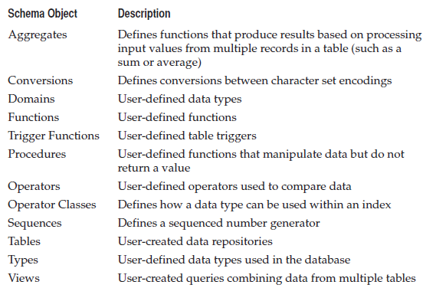
Schemas (3/3)

Slide 16
Creating the Tables
Notes:
There are a few rules for defining table names in PostgreSQL:
Must be unique within a schema
Must start with a letter or an underscore (_)
Subsequent characters can be letters, numbers, underscore, or a dollar sign ($)
Must be 63 or fewer characters long
Case sensitive
When creating a new table, you must specify the tablespace where the table will be stored.

Slide 17
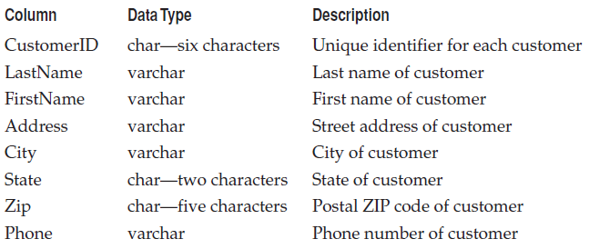
Customer Table Columns

Slide 19
Common PostgreSQL Data Types
Name | Aliases | Description
bigint | int8 | signed eight-byte integer
bigserial | serial8 | autoincrementing eight-byte integer
bit [ (n) ] |  | fixed-length bit string
bit varying [ (n) ] | varbit [ (n) ] | variable-length bit string
boolean | bool | logical Boolean (true/false)
box |  | rectangular box on a plane
bytea |  | binary data (“byte array”)
character [ (n) ] | char [ (n) ] | fixed-length character string
character varying [ (n) ] | varchar [ (n) ] | variable-length character string
date |  | calendar date (year, month, day)
double precision | float8 | double precision floating-point number (8 bytes)
inet |  | IPv4 or IPv6 host address
integer | int, int4 | signed four-byte integer
money |  | currency amount, two-decimal place floating-point number
numeric [ (p, s) ] | decimal [ (p, s) ] | exact numeric of selectable precision
real | float4 | single precision floating-point number (4 bytes)
smallint | int2 | signed two-byte integer
smallserial | serial2 | autoincrementing two-byte integer
serial | serial4 | autoincrementing four-byte integer
text |  | variable-length character string
time [ (p) ] [ without time zone ] |  | time of day (no time zone)
time [ (p) ] with time zone | timetz | time of day, including time zone
https://www.postgresql.org/docs/11/datatype.html
Notes:
https://www.postgresql.org/docs/11/datatype
Money Data Type
The money data type is an abstract data type. Money values are stored significant to two decimal places. .html

Slide 20
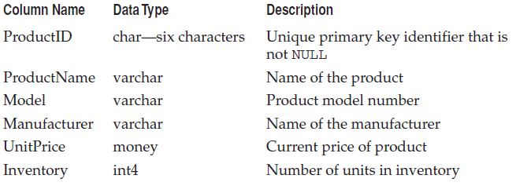
The Product Table Columns
Notes:
Money Data Type
The money data type is an abstract data type. Money values are stored significant to two decimal places. These values are rounded to their amounts in dollars and cents or other currency units on input and output, and arithmetic operations on the money data type retain two-decimal-place precision.
Money columns can accommodate the following range of values:
$-999,999,999,999.99 to $999,999,999,999.99
A money value can be specified as either:
•A character string literal—The format for character string input of a money value is $sdddddddddddd.dd. The dollar sign is optional and the algebraic sign (s) defaults to + if not specified. There is no need to specify a cents value of zero (.00).
•A number—Any valid integer or floating point number is acceptable. The number is converted to the money data type automatically.
On output, money values display as strings of 20 characters with a default precision of two decimal places. The display format is:
$[-]dddddddddddd.dd

Slide 21
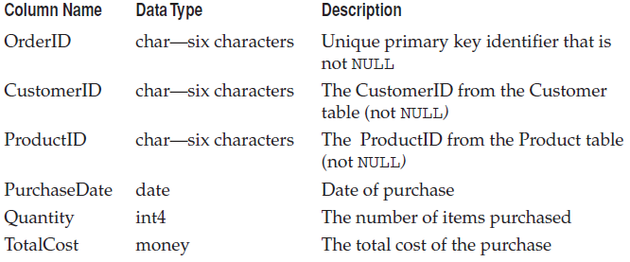
The Columns for the Order Table

Slide 22
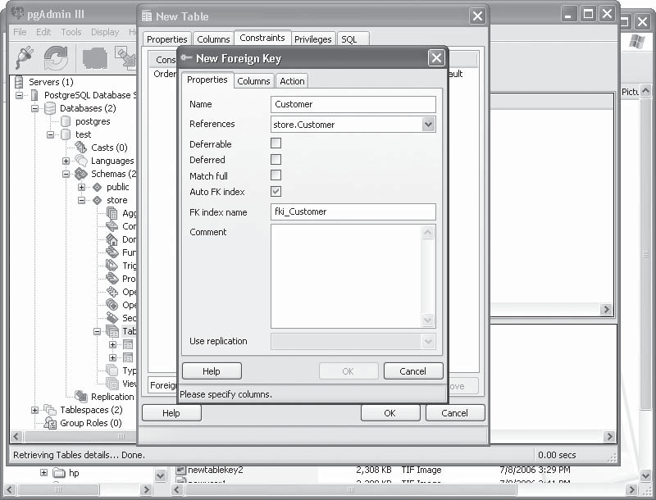
New Foreign Key window for the Order table
Notes:
- RESTRICT prevents deletion of a referenced row.
- NO ACTION means that if any referencing rows still exist when the constraint is checked, an error is raised; this is the default behavior if you do not specify anything.
(The essential difference between these two choices is that NO ACTION allows the check to be deferred until later in the transaction, whereas RESTRICT does not.)
- CASCADEspecifies that when a referenced row is deleted, row(s) referencing it should be automatically deleted as well
- There are two other options: SET NULL andSET DEFAULT. Note that these do not excuse you from observing any constraints. For example, if an action specifies SET DEFAULT but the default value would not satisfy the foreign key constraint, the operation will fail.

Slide 23
Entering and Viewing Data
Notes:
Right-click the table object you want to enter data into and choose the View Data menu item.
By default, the Edit Data window displays all of the records contained in the table and sorts them in ascending order based on the defined primary key. You can use the Sort/Filter option button (the funnel icon) to change this. Clicking this button produces the View Data Options window (a slight misnaming of windows and icons), which has two tabs:
Data Sorting Allows you to specify how to sort data as it is displayed in the Edit Data window.
Filter Allows you to specify what data to view using simple expressions. You can use standard comparison expressions within the Filter tab to filter the data you are looking for.

Slide 24
Violating column constraint
Notes:
Right-click the table object you want to enter data into and choose the View Data menu item.
By default, the Edit Data window displays all of the records contained in the table and sorts them in ascending order based on the defined primary key. You can use the Sort/Filter option button (the funnel icon) to change this. Clicking this button produces the View Data Options window (a slight misnaming of windows and icons), which has two tabs:
Data Sorting Allows you to specify how to sort data as it is displayed in the Edit Data window.
Filter Allows you to specify what data to view using simple expressions. You can use standard comparison expressions within the Filter tab to filter the data you are looking for.

Slide 25
THE pgADMIN III QUERY TOOL
Notes:
Tools | Query Tool

Slide 26
3. Parts of the PostgreSQL system

Slide 27
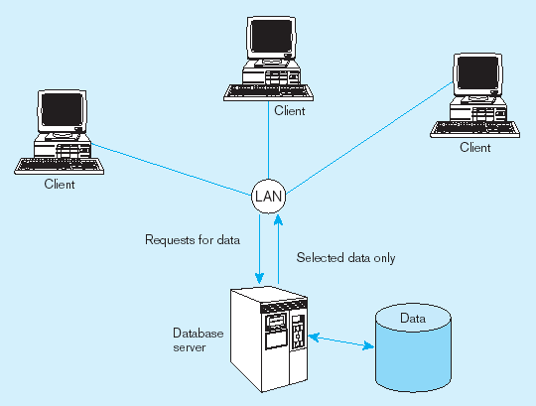
Two-tier Database Server Architecture

Slide 28
Database System Structure
Database Server
Database Cluster
Database
pg_database,
pg_role
Database Schema
Tablespace
User
Defined
Public
System
Catalog
Database Object Definition
(table, trigger, function, permission)

Slide 29
Database Server
Database server
A computer program that provides database services to other programs (client applications) that access the server via a network
A database server divides a client application onto:
A front end that runs on a user’s computer and typically performs simple tasks as displaying results
A back end that runs on the server computer and performs:
User authentication,
Transaction control,
Query optimization,
Database access

Slide 30
Database Cluster
A database cluster is a directory on disk where all database data will be stored (data area)
Data in a cluster is stored as a collection of databases
Cluster databases are managed by a single server instance
After initialization, a database cluster contains:
A database named postgres,
A database named template1
A database named template0,
…

Slide 31
5 basic components
Tablespaces
Databases
Schemas (listed under each individual database)
Group Roles
Login Roles

Slide 32
Tablespaces (1/2)
Table spaces allow a DBA to define locations in the file system where the files representing database objects can be stored
Advantages of using table spaces:
If the partition or volume on which the cluster was initialized runs out of space and cannot be extended, a table space can be created on a different partition and used until the system has been reconfigured
Table spaces allow a DBA to optimize performance by placing mission critical database objects (like indexes) on highly reliable and fast devices

Slide 33
Tablespaces (2/2)
After initialization, two default tablespaces created:
pg_default: the default location for all database objects
pg_global: hold PostgreSQL system catalogs, containing internal Data Dictionary information
When new database objects are created, you must specify which tablespace are they are stored in
Creating a new tablespace:
must point to an empty directory on the system → create directory first
postgres must have permission to write to the directory
default: postgres is a normal account →grant permission to directories
Notes:
GRANT { CREATE | ALL [ PRIVILEGES ] } ON TABLESPACE tablespace_name [, ...] TO { [ GROUP ] role_name | PUBLIC } [, ...] [ WITH GRANT OPTION ]

Slide 34
Databases (1/2)
The core objects in PostgreSQL
Each client connection to the server can access the data in only one database
To access data in more than one database a client must make more connections
The default database created during the PostgreSQL installation is postgres:
contains the default system tables for handling the internal PostgreSQL Data Dictionary
template0 and template1 (NOT shown in pgAdmin III) are used to create new databases
template1 can be modified
Notes:
If you need to create lots of database objects with certain features or objects, you can modify the template1 database template to include the features and objects, then use it as the master template to create all of your new databases. Each new database will have the same features and objects as the template1 database template.
The template0 database template cannot be modified and always describes a generic PostgreSQL database object. This template uses the pg_default tablespace, and any new databases created with this template will always use the pg_default tablespace.

Slide 35
Databases (2/2)
Each database object contains 4 types of objects:
Casts: control how Postgres casts from one datatype to another (NOT view in pgAmin III)
Languages: these are the languages you can define stored functions, aggregates and triggers in (NOT view in pgAmin III)
Schemas: the most important objects within the database, containing the tables, triggers, functions, views, and other objects for handling data
Replications: define copies (or replicas) of the PostgreSQL database in a fault-tolerant operation

Slide 36
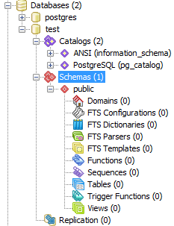

Slide 37
Template
CREATE DATABASE actually works by copying an existing database
Default, it copies the standard system database template1
There is a second standard system database named template0
the same data as the initial contents of template1
never be changed

Slide 38
Schemas
The most important objects within the database
A database contains one or more schemas, which contain database object (table, data type, domain, function, trigger) definitions
While users can only access objects within one database at a time, they can access all of the schemas within that database, if it has permissions
Unlike databases, schemas are not rigidly separated
Notes:
Sometimes related applications can share the same database, but use different schemas to hold their separate data. This makes it easier for users to find data tables related to the applications within the database. This is especially true if tables have the same names.
Table names must be unique within a schema, but can be duplicated between schemas. Tables are referenced in SQL statements using the format: schemaname.tablename

Slide 39
Catalogs
A pgAdmin catalog is a schema
Hold meta data information and built-in Postgres objects
2 types:
system catalog: pg_catalog
information catalog: information_schema

Slide 40
The System Catalog
Every database system must have a meta-database of information on the schema which it contains.
The names of the relations in the schemas
The names of the columns of each relation.
The data type of each column.
The integrity constraints on the relations.
Information about indices on the relations.
The access privileges for the elements of the schema.
This database is often called the system catalog.

Slide 41
The System Catalog Schema
Each PostgreSQL database contains a pg_catalog schema
Normaly, it is copied from the template1 database
The pg_catalog schema contains tables with information about database objects like:
Schemas (pg_namespace)
Tables, indexes, sequences, and views (pg_class),
Data types (pg_type),
Functions and procedures (pg_proc),
Table columns (pg_attribute),
Check, unique, primary key, and foreign key constraints (pg_constraint),
Aggregate functions (pg_aggregate),
Triggers (pg_trigger),
Planner (optimizer) statistics (pg_statistics), and
Many others
Notes:
The pg_global tablespace is used to hold PostgreSQL system catalogs. The system catalogs contain internal Data Dictionary information for the PostgreSQL system to operate. You should not create new database objects within this tablespace.
The difference between template0 and template1 is that template1 can be modified. If you need to create lots of database objects with certain features or objects, you can modify the template1 database template to include the features and objects, then use it as the master template to create all of your new databases. Each new database will have the same features and objects as the template1 database template. The template0 database template cannot be modified and always describes a generic PostgreSQL database object. This template uses the pg_default tablespace, and any new databases created with this template will always use the pg_default tablespace.

Slide 42
Information_schema and pg_catalog
The pg_catalog schema is the standard PostgreSQL meta data and core schema.
The information_schema is part of the ANSI standard, but is not quite so standard. Oracle and DB2 evidentally still don't support
A lot of this information overlaps with information found in the information_schema and pg_catalog, but the information_schema is much easier to query
Although not named explicitly in the search_path, pg_catalog is the first schema to be searched
SELECT * FROM pg_tables
SELECT * FROM pg_catalog.pg_tables
Notes:
American National Standards Institute

Slide 43
Group Roles
Create access permissions for groups of users
While you can grant an individual user account access directly to a database object, the preferred method is to use Group Roles
pgAdmin III only allows you to grant Group Roles access to database objects
Default, public group role:
applies to all users on the PostgreSQL system
NOT able to remove any user account from the public Group Role
does not appear in the pgAdmin III Group Roles listing

Slide 44
Login Roles (or user accounts)
Are roles that are allowed to log into the PostgreSQL server
Each database user should have an individual account for logging into the PostgreSQL system
That account is then assigned as a member of the appropriate Group Roles that grant privileges to the database objects required
Allows you to easily change access for database objects without having to touch hundreds (or even thousands) of individual user Login Roles

Slide 45
Practices – (continue…)
Create a database test
Customer
Product
Order
Create two Group Roles
Salesman Group Role: write permission on the Customer and Order, only read permission on the Product
Accountant Group Role: write permission on the Product and Order, read permission on the Customer
Create two Login Roles
salesman - Barney
accountant - Fred

Slide 46
WORKING WITH USER ACCOUNTS

Slide 47
Notes:
Double-click the Customer table icon in pgAdmin III. The Table Properties window appears for the table. Click the Privileges tab, showing the configuration window to set permissions on the table

Slide 48
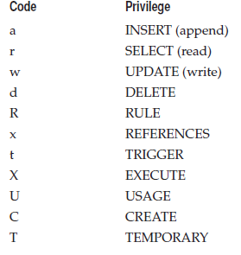
pgAdmin Object Privilege Codes

Slide 49
Creating Login Roles
Notes:
In the Role Privileges section, you must select the Inherits Rights from Parent Roles check box. This ensures that the Login Role will inherit the privileges assigned to the Group Role it is assigned to.
After filling in the Properties tab, click the Role Membership tab. This is where you assign the Login Role to one or more Group Roles. For a Salesman account, click the Salesman group name in the left box and click the right arrows. The Salesman group name is added to the Member In list.

Slide 50
Testing
log in using the test database and the fred Login Role
psql test fred
test=>INSERT into store."Product" VALUES ('LAP001', 'Laptop', 'TakeAlong', 'Acme', '500.00', 100);
test=>
test =>INSERT into store. "Customer"("CustomerID", "LastName", "FirstName")VALUES ('Cus001', 'Thi Oanh', 'Nguyen');
Notes:
Permission denied for schema store ➔ can dat quyen su dung (USAGE) tren schema store

Slide 51
DATABASE MAINTENANCE
Notes:
PostgreSQL provides a method called vacuuming to remove records marked for deletion.

Slide 52
Notes:
To manually vacuum a table or database, right-click the table or database object and select Maintenance. The Maintain Table (or Database) window appears

Slide 53
BACKUPS AND RESTORES

